Slide 1

Class. Inheritance

Slide 2
Last Lesson
Ref, Out
Stack, Heap
Parameters
Array
String, StringBuilder

Slide 3
Today’s Lesson
Class
Constructor
Aggregation
Partial Class
OOP principles. Inheritance

Slide 4
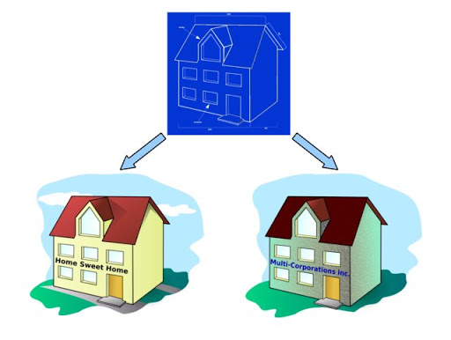
Object & Class
array.Length ?
Class
Properties
Obj = new …
Initialization
Setting
Getting

Slide 5
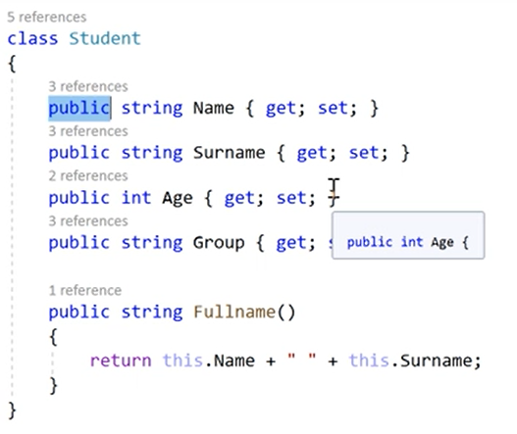
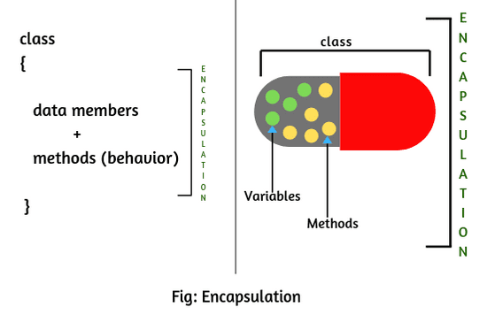
Methods and Encapsulation
Private vs Public
Methods

Slide 6
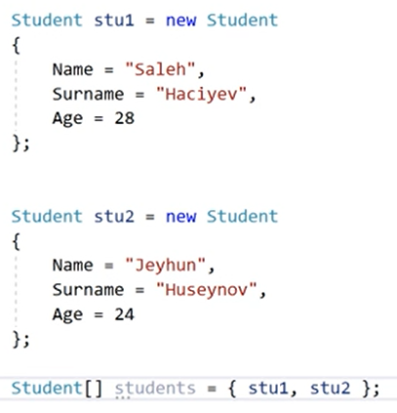
Objects and Arrays
Notes:
I+3 instead of i++

Slide 7
Constructor
Constructors are a type of method
Share the name of the Class
Called when you instantiate the Class
Can include Multiple Constructors
This.
Notes:
Please Provide Examples

Slide 8
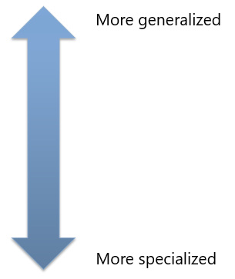
Inheritance
Classes Extending each other
Ex Car and Vehicle,
Ex Dog and Animal,
Ex Student and Person
Etc.
Similarity with SQL, Relations between classes
One to Many, Many to One - Aggregation
BMW
CAR
VEHICLE

Slide 9
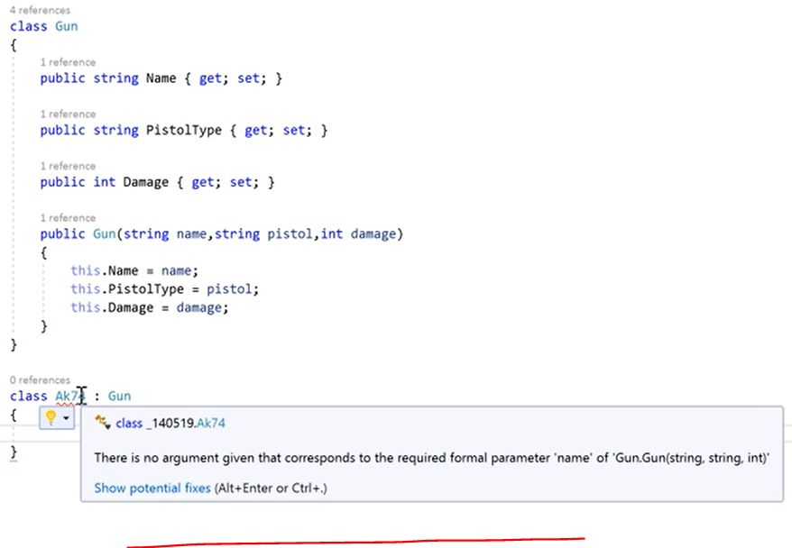
Importance of Base

Slide 10
Base
To call a base class constructor from a derived class, add the base constructor to your constructor declaration
public Coffee(string name, bool isFairTrade, int temp)
: base(name, isFairTrade, servingTemp)
Pass parameter names to the base constructor as arguments
Do not use the base keyword within the constructor body
To call base class methods from a derived class, use the base keyword like an instance variable
base.GetServingTemperature();

Slide 11
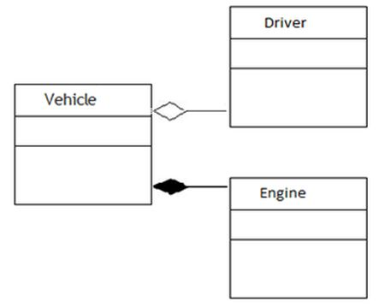
Notes:
Has-a
Is-a part of
Is-a

Slide 12
Thanks!

